Slide 1
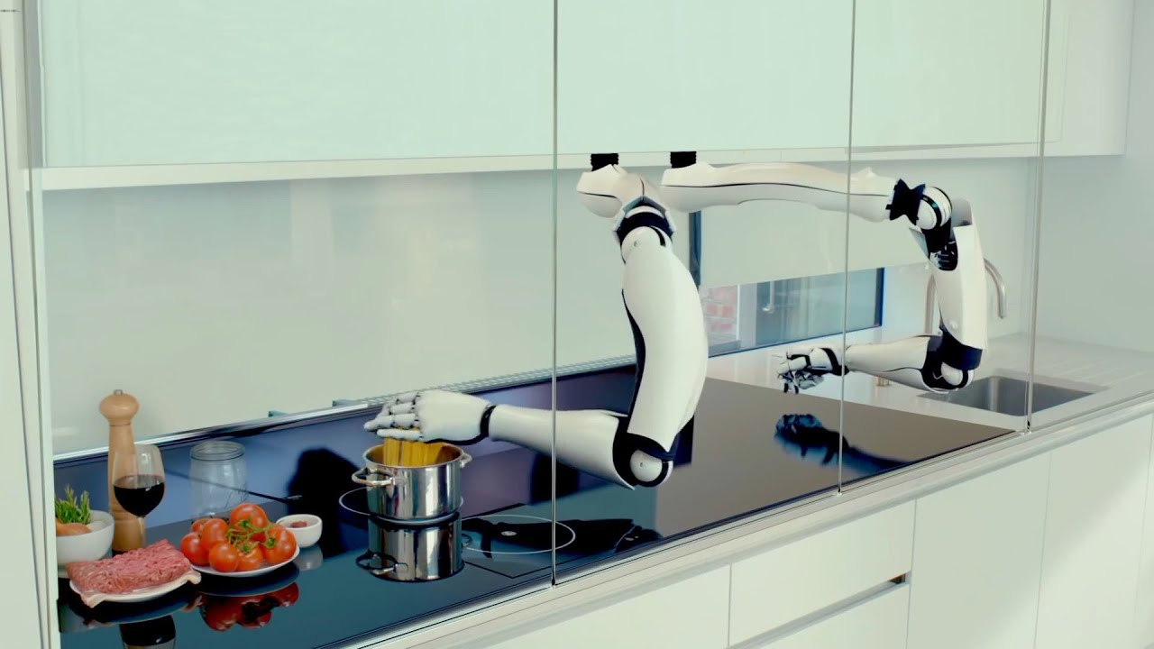

The Moley Robotic Kitchen
Notes:
Mark oleynik

Slide 2
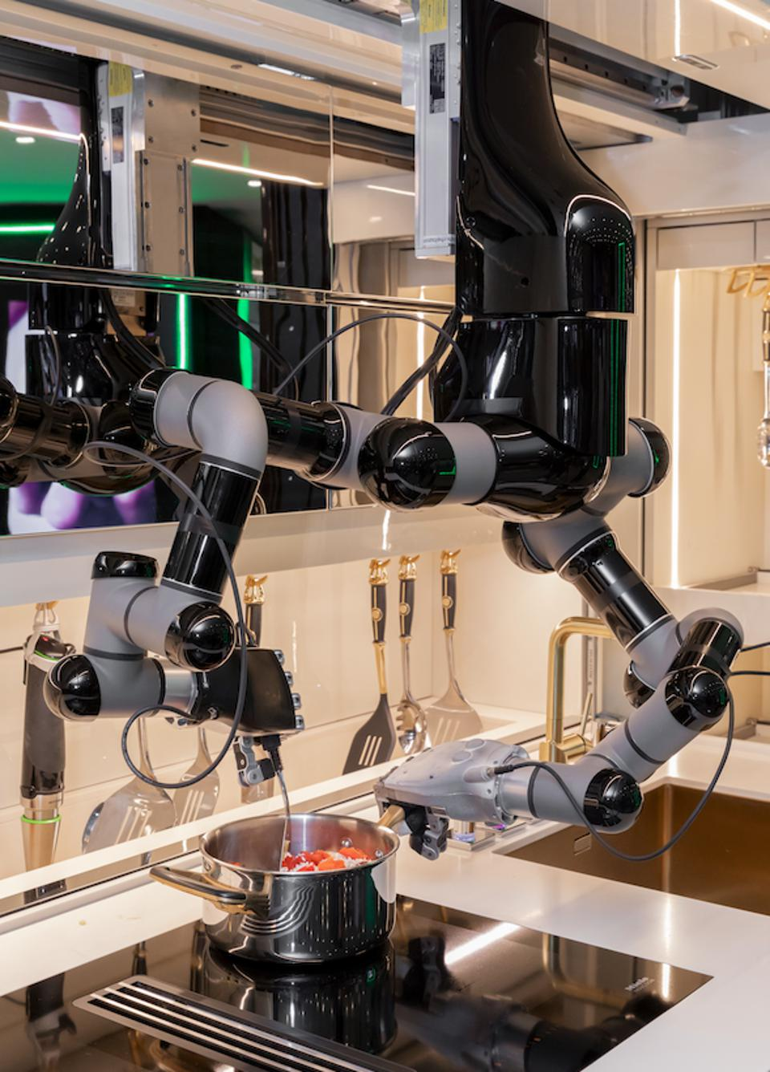
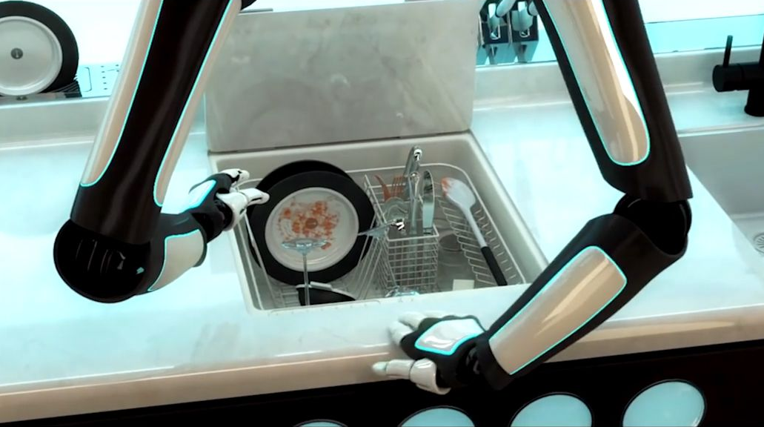
What is it ?

Slide 3
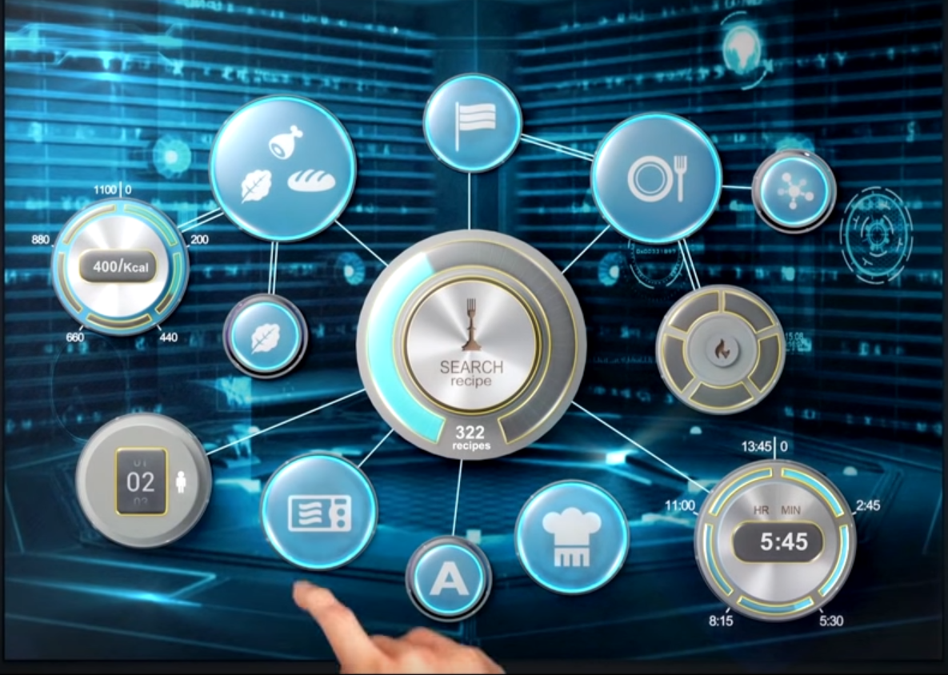
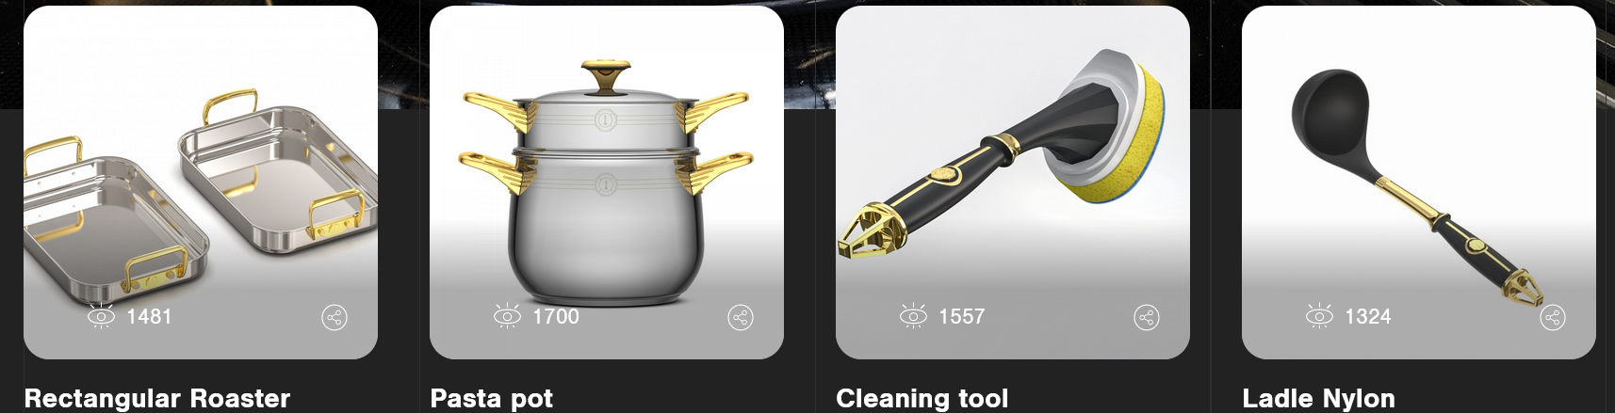
How does it work ?
Own utensils
Own appliances (dishwasher / oven)
Interface
Chose the recipe
Monitor the progress

Slide 4
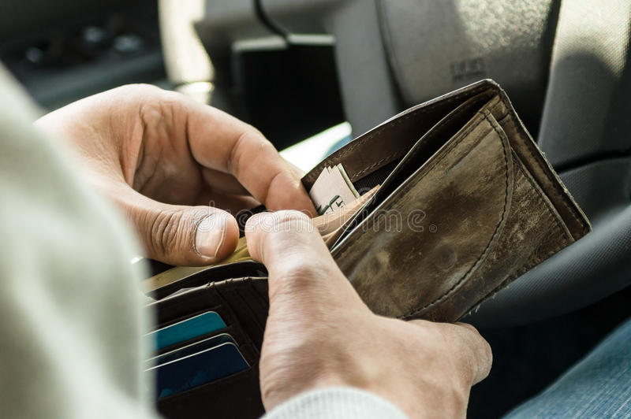

How much it cost ?

Slide 5
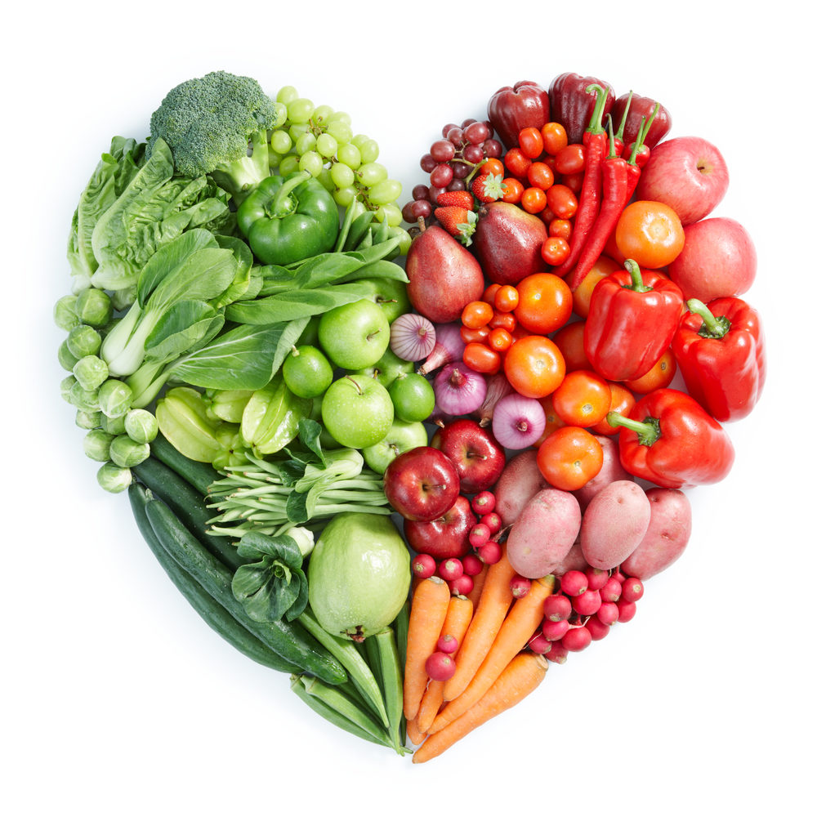
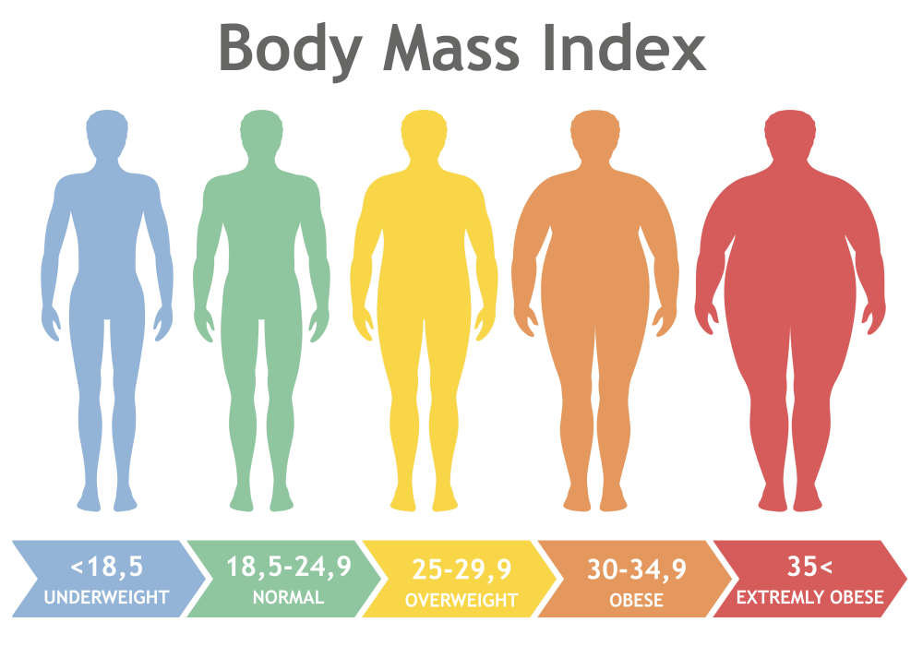

Who is going to use it ?
Goal : reduce obesity in USA
healthy food / no time

Slide 6

What do we think of that (benefits and drawbacks) ?

